Slide 1



#74 AUTO-COMPLETE FOR MUSIC
Rachel Nataatmadja and Shou Miyamoto
Notes:
Hi everyone, my name is Rachel and this is Shou. Our project is auto-complete for music

Slide 2
01.
PROJECT BACKGROUND AND CONTRIBUTIONS
02.
OUR MODEL AND EXPERIMENTATIONS
03.
EVAULATION METRICS
04.
CONCLUSION
TABLE OF
CONTENT
Notes:
First, I will go over the project background and contributions towards this research. I will also explain our model structure and process for music generation.
From there, I will pass on to shou who will talk about our experimentations and evaluation metrics.

Slide 3
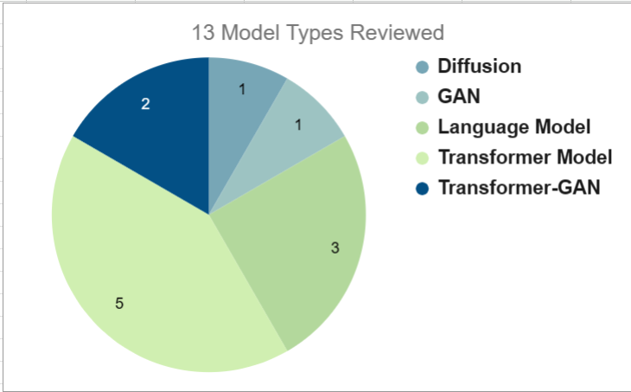
PROJECT BACKGROUND - INITIAL PROMPT
Investigate developing a tool, potentially tailoring language models like GPT-3, to aid a composer in writing music by predict future notes based on the current notes.
Notes:
Generative AI has become increasingly popular over the past few years, especially in the creative arts industry.
Currently, music generation models are being used as tools for composers to inspire creativity.
Our initial research prompt was to
From this prompt, we have researched 13 music generation models, 5 of which were transformers. From these models we found...

Slide 4
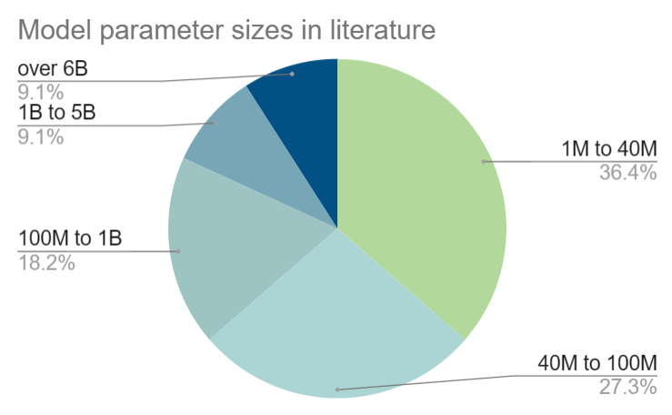
PROJECT BACKGROUND
Music generation models are used as inspirations for composers.
High complexity in recent music generation models.
Requires high computational resources
Inaccessible to composers who has low-income, in developing nations or has unreliable internet.
Notes:
Recent music generation models have become increasingly complex in an attempt to generate realistic-sounding music. Over 63% of the models we reviewed had over 40 million parameters, as you can see in the pie chart.
While the music generated from these models are almost realistic to a human composition, the models require high computational resources to run such as a computer with multiple GPUs. This makes it inaccessible to composers who are financially struggling or in developing nations.
Even if these models are hosted online through in-cloud executions, composers who don't have reliable internet connections won't be able to use them.

Slide 5
PROBLEM
Can we get adequate music generation while lowering the computational requirement to produce and run the model?
Notes:
Which brings us to our final problem statement.

Slide 6
CONTRIBUTIONS
We propose:
Lightweight model that can be used on edge devices.
Lower complexity and relatively fast generation time.
Performs to a similar degree as state-of-the-art music generation models.
Music from the classical genre.
Objective evaluation metrics.
Demonstration of our project.
Notes:
Our contributions to this research project are:
A lightweight model that can be used on edge devices such as Raspberry Pi or mobile phones.
This should have a relatively fast generation time without using a GPU or cloud-based execution.
Ideally, we want the model to generate music that is almost comparable to existing models.
We limited our model to the classical genre due to the wide variety of datasets available and the well-structured nature of those compositions. We can also avoid copyright issues if our model generates something similar to the dataset.
Additionally, since music is subjective, we also derived objective metrics to evaluate our model.
Finally, I also developed a demonstration of our model using a Python-based GUI.
Both of us have contributed to each area of our research. I have been primarily working on the model training and inferencing and the demonstration. While Shou has been primarily working on model training inferencing and evaluation metrics.

Slide 7
OUR MODEL ARCHITECTURE AND PROCESS
Encoder-only transformer model
19 Million parameters
MIDI to MIDI generation
Tokenisation preprocessing via MidiTok library
MAESTRO V3 dataset
N. Fradet, J.-P. Briot, F. Chhel, A. El Fallah-Seghrouchni and N. Gutowski, “MidiTok: A Python Package for MIDI File Tokenization,” in 22nd International Society for Music. Information Retrieval Conference, Online, 2021.
Notes:
In this section, I'll going over our model architecture and the methods we used.
Our model is an encoder-only transformer with 19 million parameters. This is the 4th lowest out of all the models we have reviewed.
We intended it to be used as a MIDI to MIDI music generation. As you can see at the bottom of our poster, we have outlined the generation process.
Firstly, we preprocess a MIDI file, extract the musical information and convert it into tokens. These tokens can then be read by the model to generate music.
Once the model has finished generation, we would convert those tokens back into MIDI and audio files for convenience.
Our preprocessing methods utilise the MidiTok library to convert MIDI information, such as pitch, velocity and duration of a note, into tokens. In particular, we have experimented with the REMI and Structured tokenizers. We also trained our model using the MAESTRO dataset.
Now I'll be passing on to shou to talk about the experiments and metrics.

Slide 8
V1.1
INITIAL TRANSFORMER MODEL
Mean Squared Error(MSE) loss function, REMI tokenizer, 147 MIDI files
V2.1
ADJUSTING REST RANGE IN TOKENIZATION
Structured tokenizer, MSE loss function, 147 Midi files V2.1 - Removed Rest range, V2.2 - Changed rest range from half beats to four beats
V3.1
LOSS FUNCTIONS AND ADDING MORE DATA
MSE loss vs Cross-entropy loss function, 272 MIDI files, Structured Tokenizer, Rest range half to four beats
V4.1
ADDED POSITIONAL ENCODING LAYER
MSE loss vs Cross-entropy loss function, 274 MIDI files, Structured tokenizer, Rest range half to four beats
EXPERIMENTS DURING TRAINING
Notes:
had a problem with silences between notes xd

Slide 9
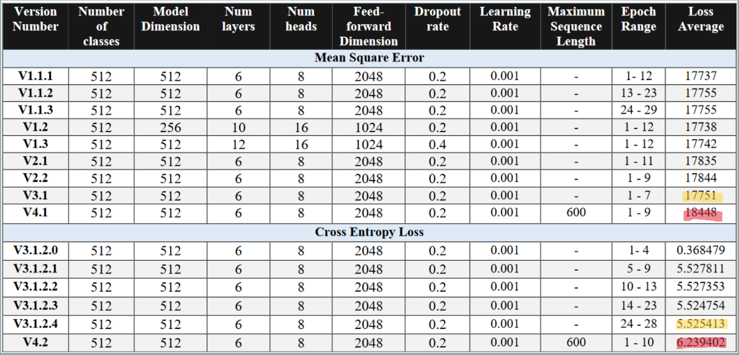

Slide 10
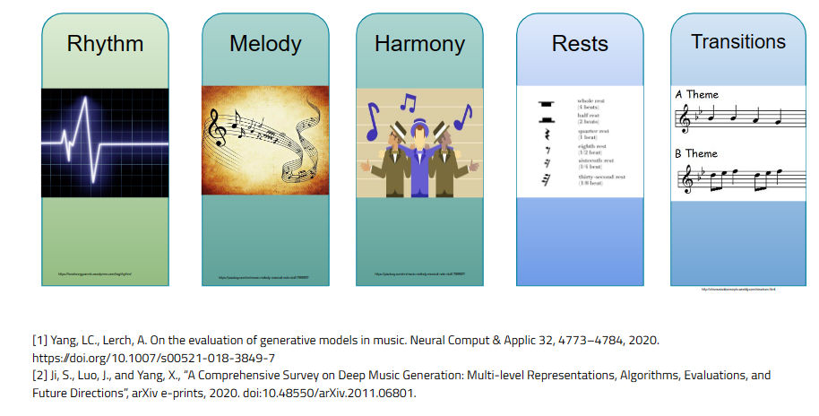
EVALUATION
METRICS

Slide 11
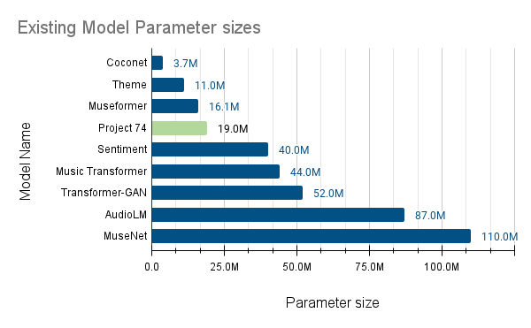
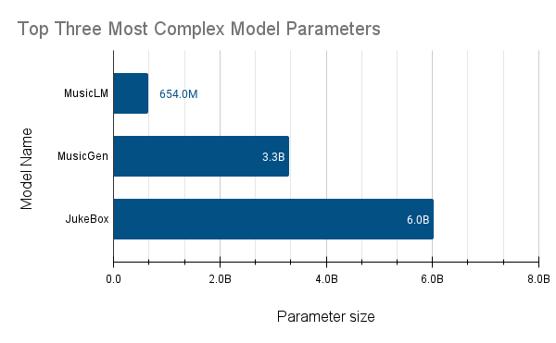
PARAMETER SIZE COMPARISON
BASIC

Slide 12
CONCLUSION

